Slide 1


Building Serverless Applications with .NET 7 and Azure functions
Fabio Cavalcante
@codesapien
Mélony Qin
@MelonyQ

Slide 2
Agenda
What and why .NET on Azure functions ?
QnA
Isolated worker enhancements
Migrating from the retired .NET versions to .NET 7
.NET Functions isolated worker process
.NET on Azure functions

Slide 3
Generally available
.NET 7 support in Azure Functions 🎉
.NET Framework support in Azure Functions v4 🎉

Slide 4


Azure Functions
An event-driven, serverless compute service that accelerates app development
Integrated programming model
Supported various triggers and bindings to define when a function is invoked and to what data sources it connects
End-to-end development experience
Local end-to-end development experience with Functions from building and debugging locally on major platforms like Windows, macOS, and Linux to deploying and monitoring in the cloud
Hosting options flexibility
Choose the host environments that better fits your business needs without compromising development experience
Fully managed and cost-effective
Automated and flexible scaling based on your workload volume, keeping the focus on adding value instead of managing infrastructure

Slide 5
End-to-end development experience
Microsoft Azure
Local development tool chain:
Visual Studio 2022
VS Code
Azure Functions Core Tools
Local
CI & CD:
GitHub Actions
Azure DevOps
Develop
Debug
Deploy

Slide 6
Why isolated worker process ?
Isolated process from function runtime
Decoupled from the host .NET versions
More natural dependency injection
Middleware support
https://aka.ms/af-dotnet-isolated-guide

Slide 7
.NET Isolated enhancements
Performance gaps
Durable functions
SDK type bindings
Enhanced HTTP trigger
https://aka.ms/af-dotnetIsolated-enhancement

Slide 8
SDK type binding
Familiar experience
SDK abstraction
Performance benefits

Slide 9

Demo

Slide 10
Migrating to .NET 7
If you're on Azure Functions 3.0
https://aka.ms/v3-af-dotnet-migration
If you're on Azure Functions 1.0
https://aka.ms/v1-af-dotnet-migration

Slide 11
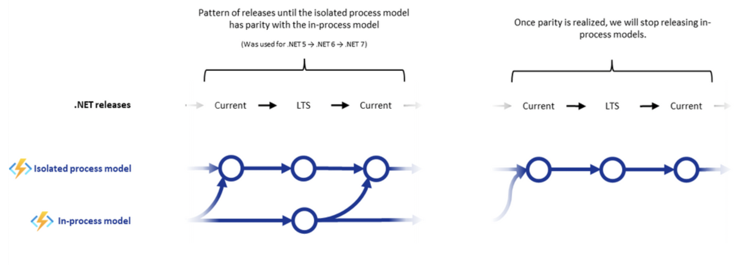
Azure Functions .NET Roadmap

Slide 12


Getting started
(Links are in the description down below ☺)
Roadmap
.NET on Azure Functions Roadmap Update here
Workstream related Public roadmap: http://aka.ms/af-dotnet-roadmap
Docs
Getting started with Azure functions in an isolated process from here.
Create your first .NET 7 functions with Azure Functions Core tools from here.
Create your first .NET 7 functions with Visual Studio 2022 from here.
Create your first .NET 7 functions with Visual Studio Code from here.
Create your .NET 7 function app from Azure portal here.

